Slide 1
Deep Currency Forensics : Counterfeit Catcher
Problem Statement: Develop an automated system utilizing deep learning techniques to detect counterfeit currency with high accuracy and reliability.
22-06-2024

Slide 2
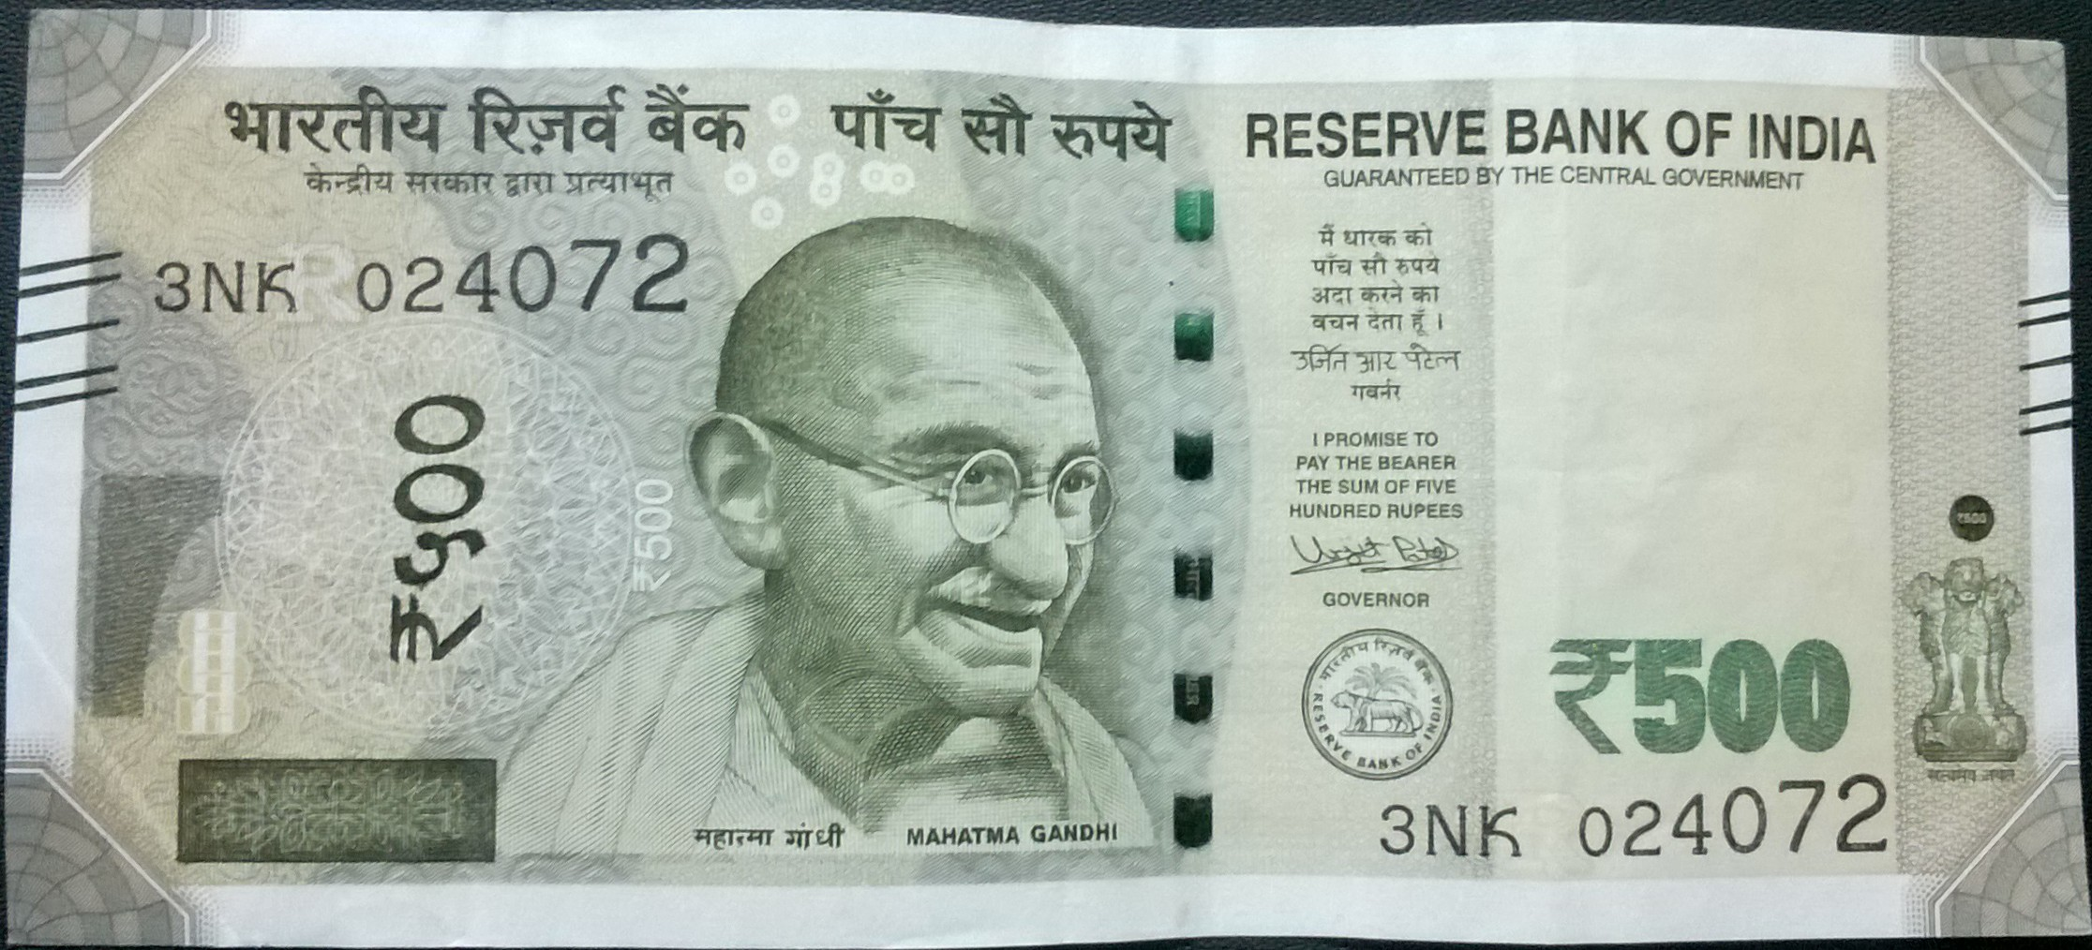
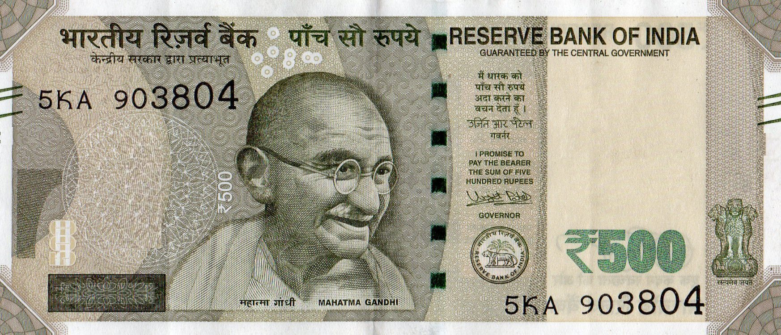
FIND THE FAKE
A
B

Slide 3
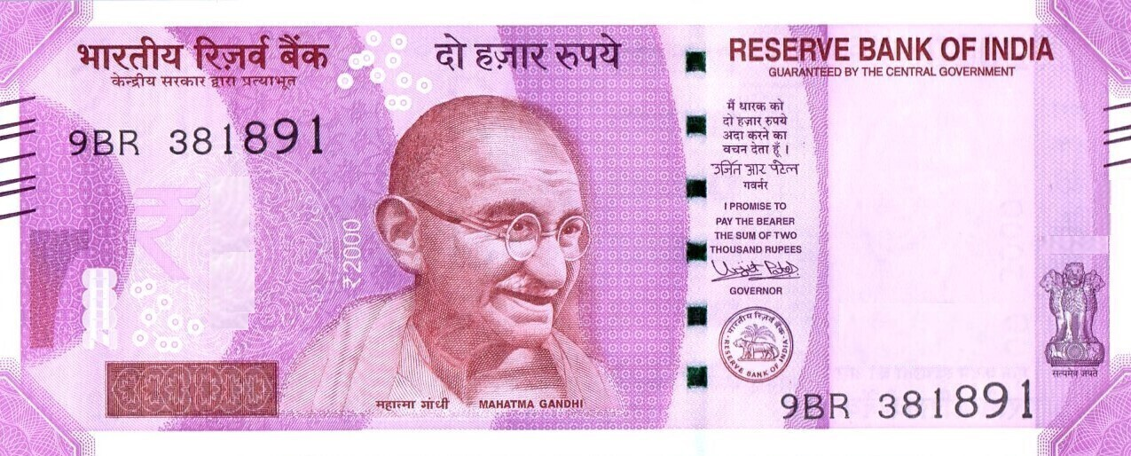
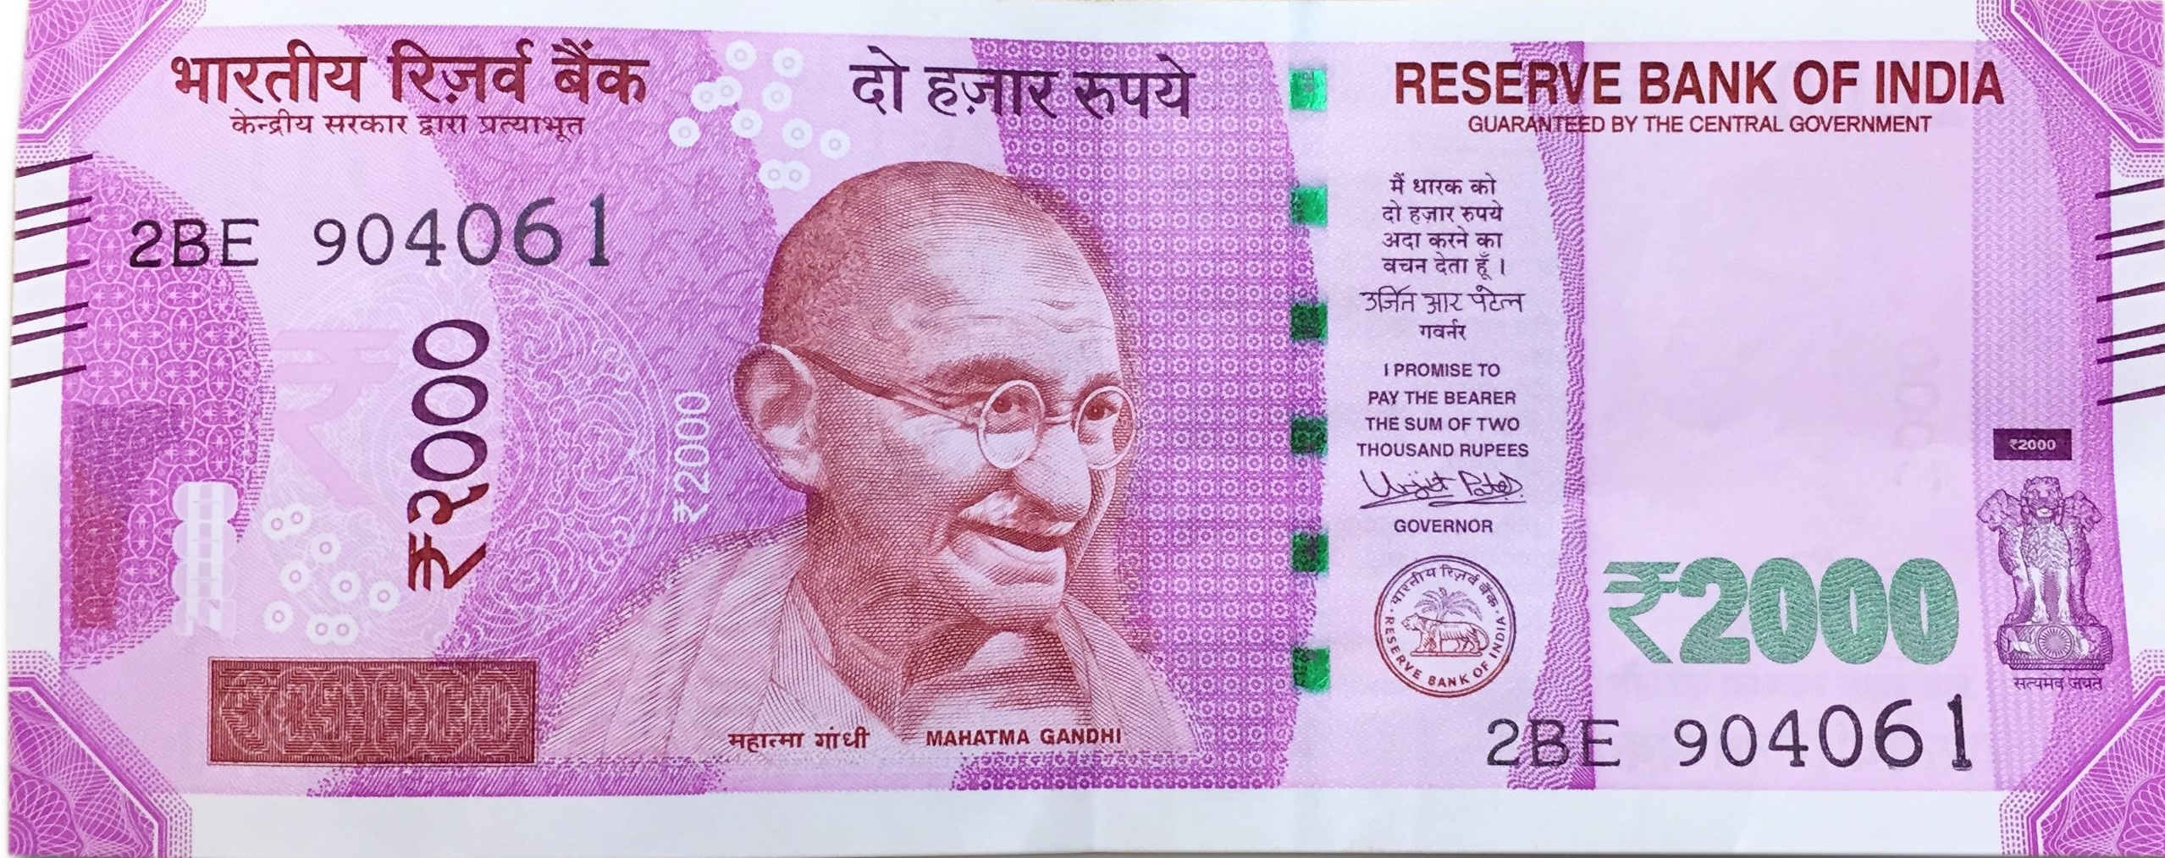
FIND THE FAKE
A
B

Slide 4
INDEX:
1) Team Introduction
2) What are we trying to build
3) Abstract
4) Most Important Use Case
5) Business Use Cases
6) Project Outline
7) Concepts we used
8) Comparative study
9) Architecture
10) Algorithms Used
11) Features extracted
12) User Interface
13) Methodology
14) Testing
11) Challenges faced
13) Future Enhancements
14) Demo
15) Conclusion

Slide 5
TEAM MEMBERS

Slide 6


Slide 7
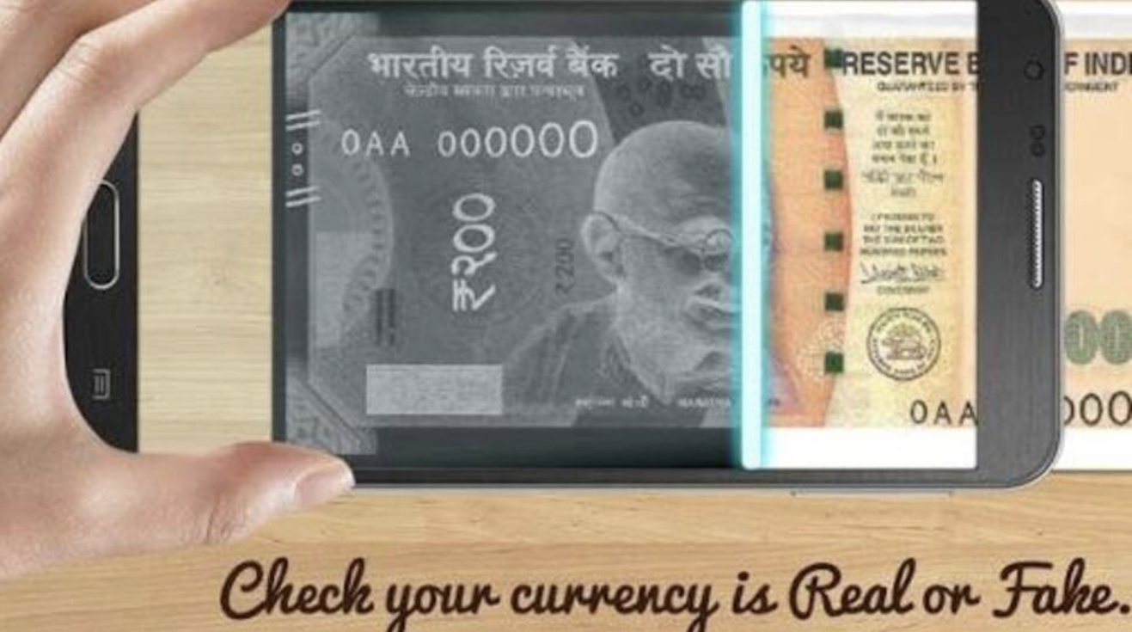
WHAT ARE WE TRYING TO BUILD:
Our project is all about making a smart system that can tell the difference between real and fake money. This system uses special tech to look closely at the money’s details, like the special marks on the currency note. We teach the system what to look for by showing it lots of pictures of real and fake money. This helps to check money quickly and see if it’s real, helping to keep fake money out of our wallets and businesses.

Slide 8

ABSTRACT
Counterfeiting is a significant issue that undermines the trust and integrity of financial systems globally. As counterfeiters become more sophisticated, the need for advanced detection methods grows. Deep Currency Forensics, often referred to as "Counterfeit Catcher," employs cutting-edge technologies, including deep learning and machine vision, to identify counterfeit currency with high accuracy.

Slide 9
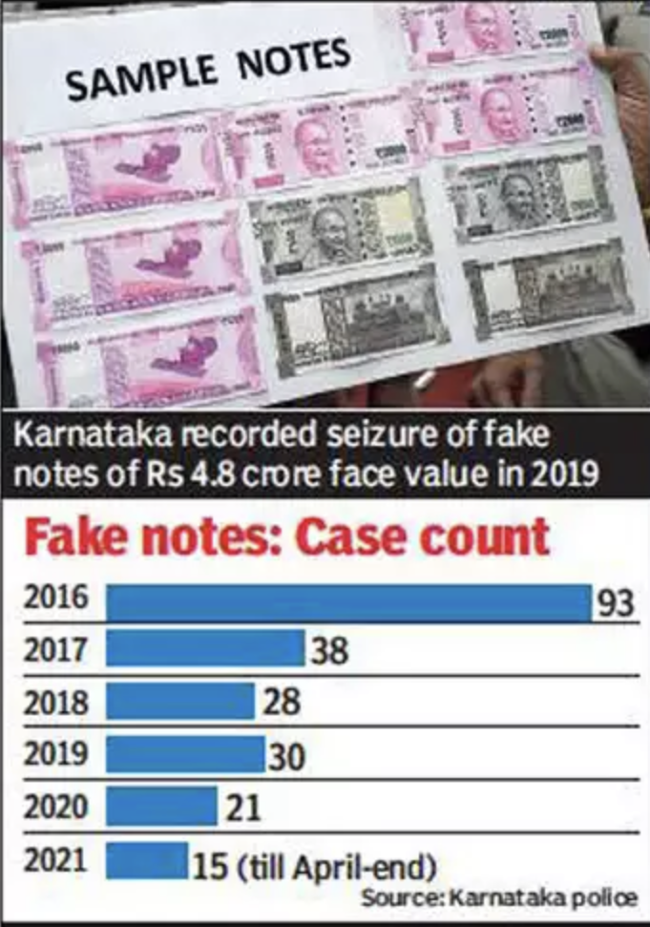
IMPORTANT USE CASE
The most important use case for a fake currency detection project is to help banks, businesses, and individuals quickly and accurately identify counterfeit money. This tool can be used at cash registers, ATMs, or by anyone who handles cash regularly to ensure that all the currency they receive or dispense is genuine, protecting them from financial loss and fraud.

Slide 10
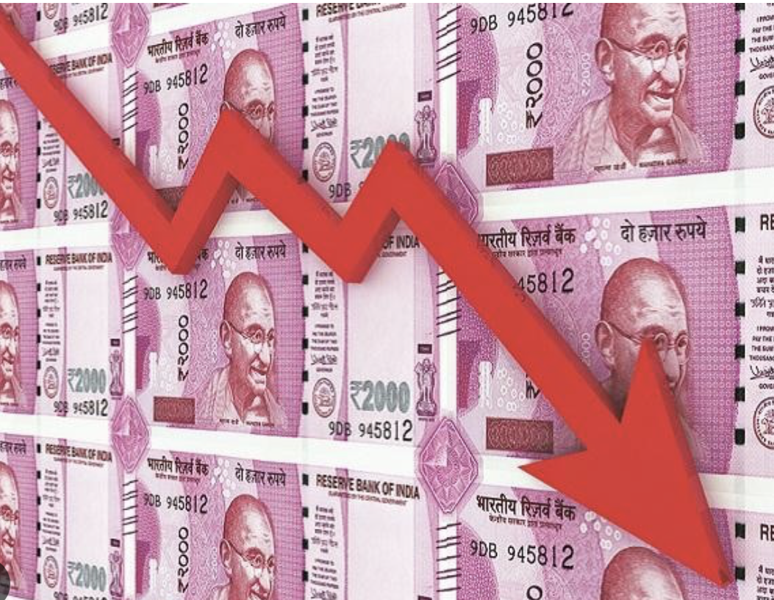
BUSINESS USE CASE
A business use case for the fake currency detection project could be for retail stores. The system can be integrated into their point-of-sale (POS) systems to scan and verify the authenticity of cash payments in real-time. This would help prevent the acceptance of counterfeit notes, reducing financial losses and maintaining the integrity of the store’s transactions.

Slide 11
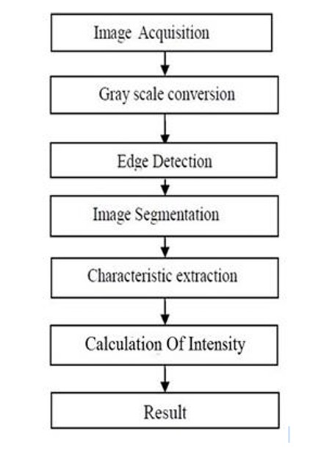
STEP WISE BREAKDOWN : CONCEPTS USED
IMAGE ACQUISITION
GREYSCALE CONVERSION
EDGE DETECTION
IMAGE SEGMENTATION
CHARACTERISTIC EXTRACTION
CALCULATION OF INTENSITY
RESULT

Slide 12
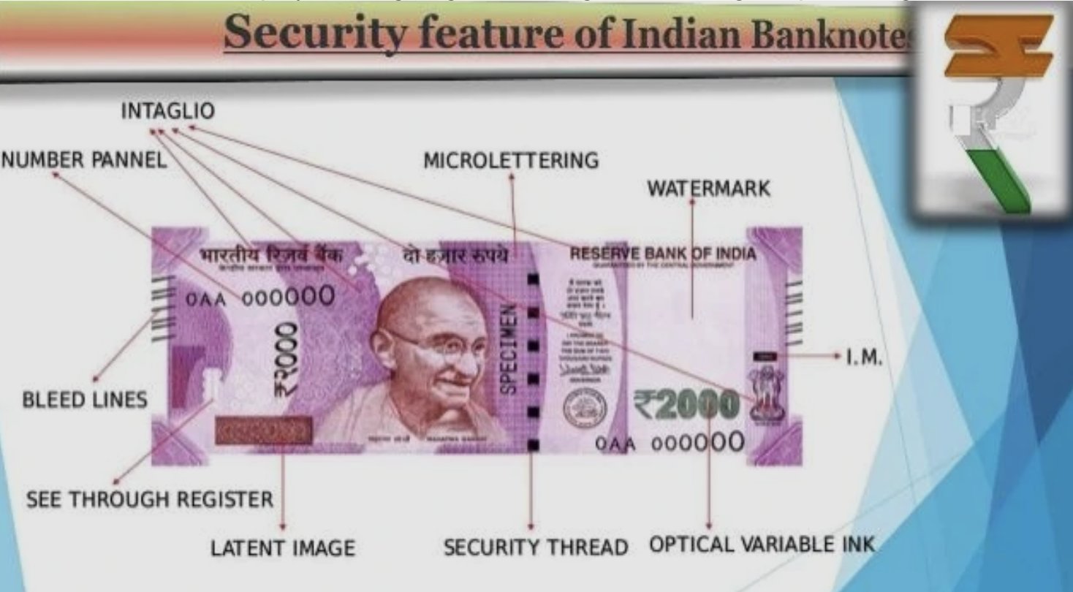
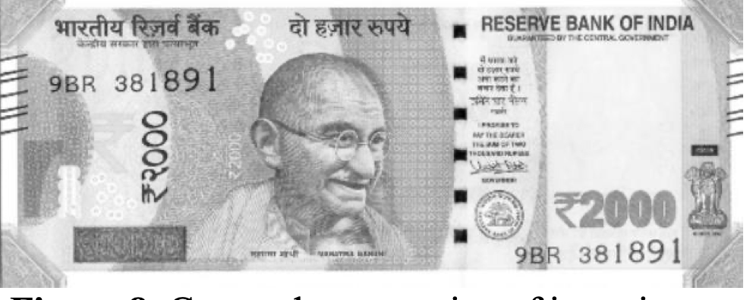
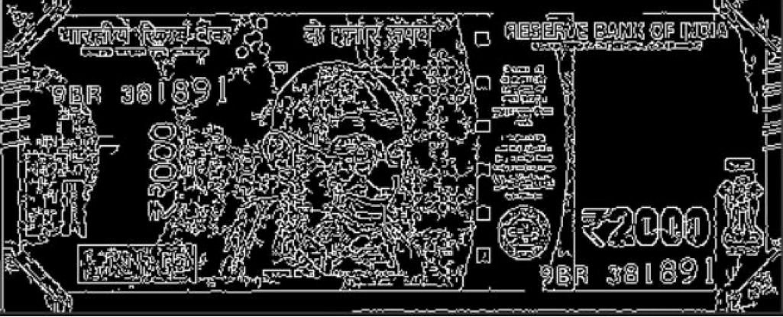

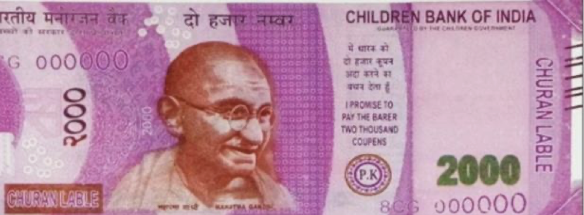
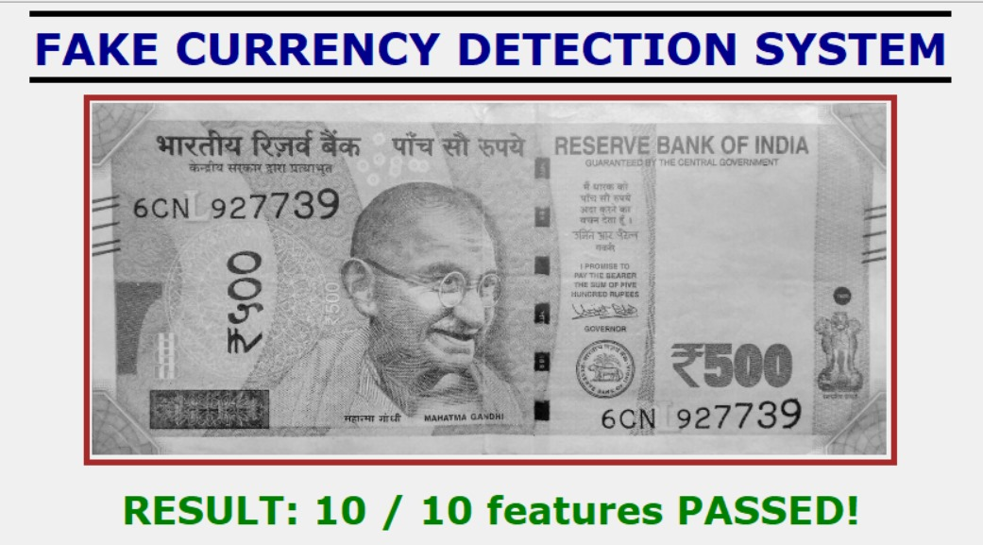
Project Outline
Greyscale Conversion:
Image Segmentation:
Input Acquisition:
Characteristic Extraction:
Result:

Slide 13
Concepts We used
Gaussian Blurring method: Gaussian blurring removes a lot of noise present in the image and increases the efficiency of the system
Feature detection and matching using ORB(Oriented FAST and Rotated BRIEF):ORB will be used to detect the template in the test image and the result will be highlighted properly with a marker.
Feature comparison using SSIM: structural Similarity Index (SSIM) is a scoring system that quantifies the image quality degradation that is caused by processing such as data compression or by losses in data transmission

Slide 14
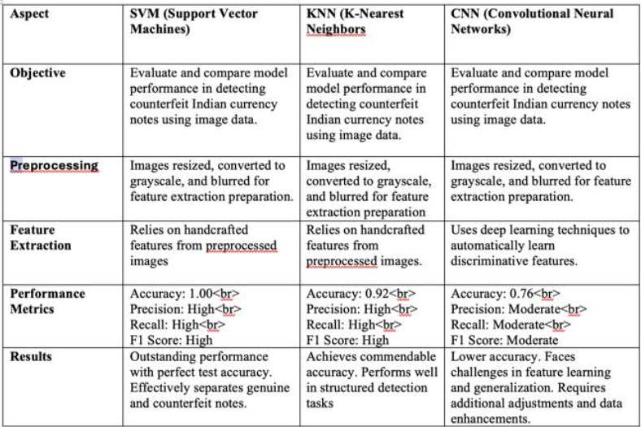
Comparative Study

Slide 15
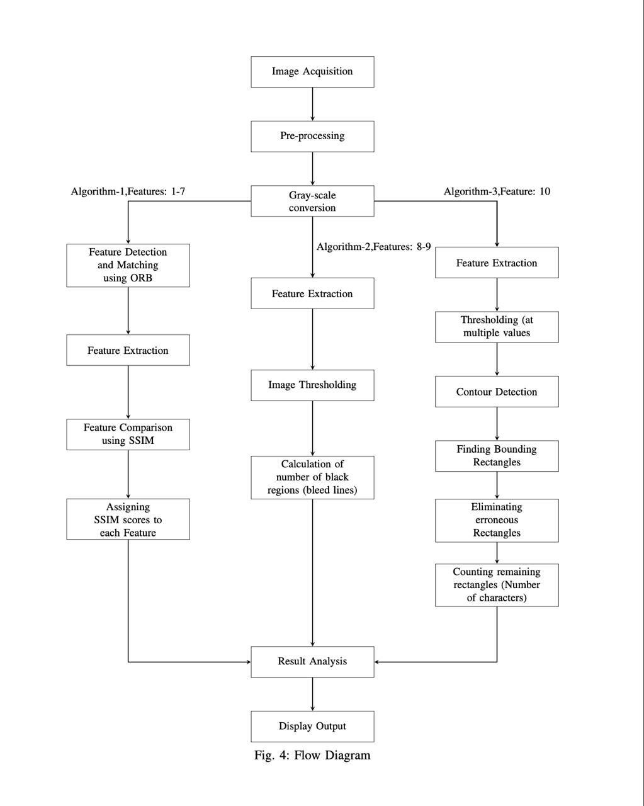
Project Architecture

Slide 16
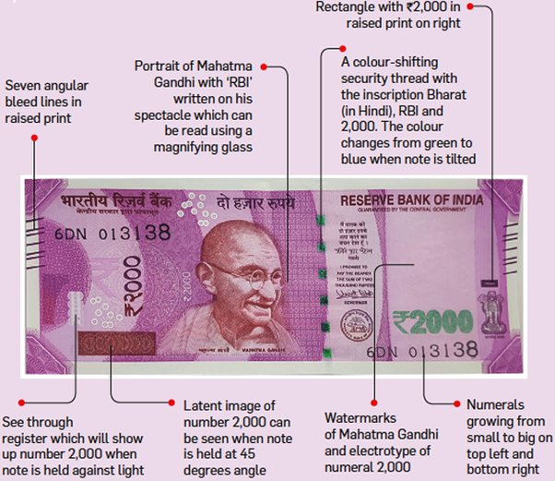
Algorithms Used
Algorithm 1 (Feature 1-7) : This algorithm finally collects the average SSIM score and the max. SSIM score for each feature.
Algorithm 2 (Feature 8-9 ):This algorithm finally returns the average number of bleed lines present in the left and right sides of a currency note.
Algorithm 3 (Feature 10) :This algorithm finally returns the number of characters present in the number panel of the currency note.

Slide 17
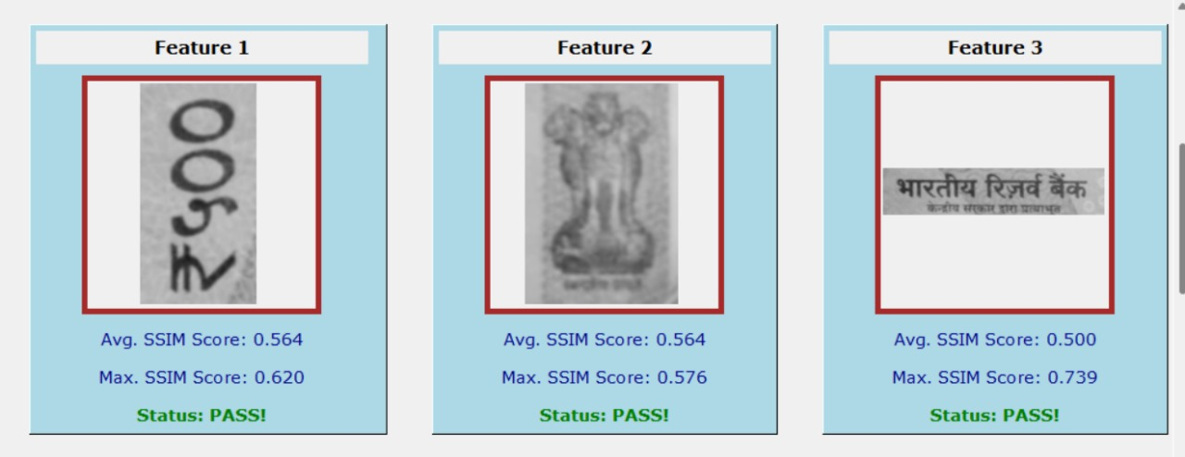
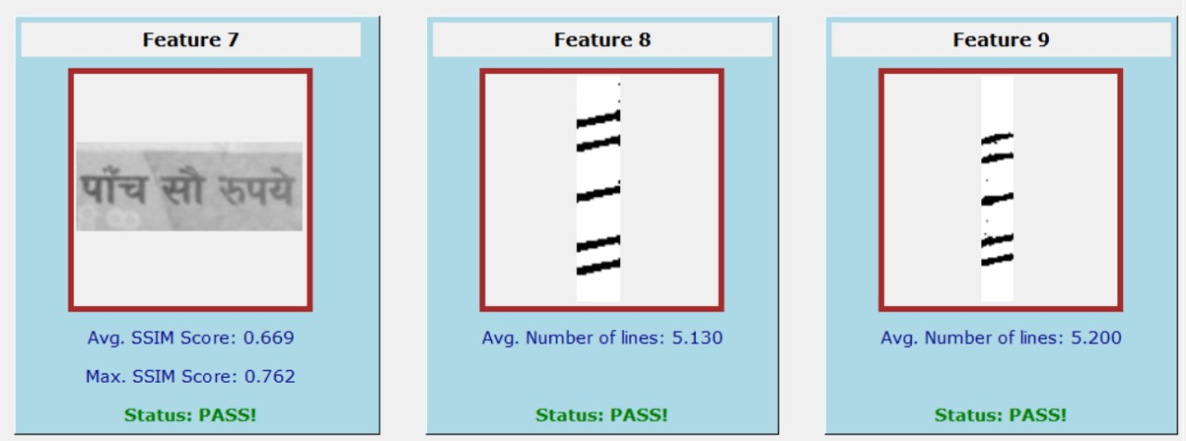
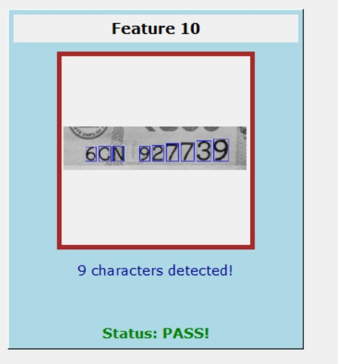
Features

Slide 18
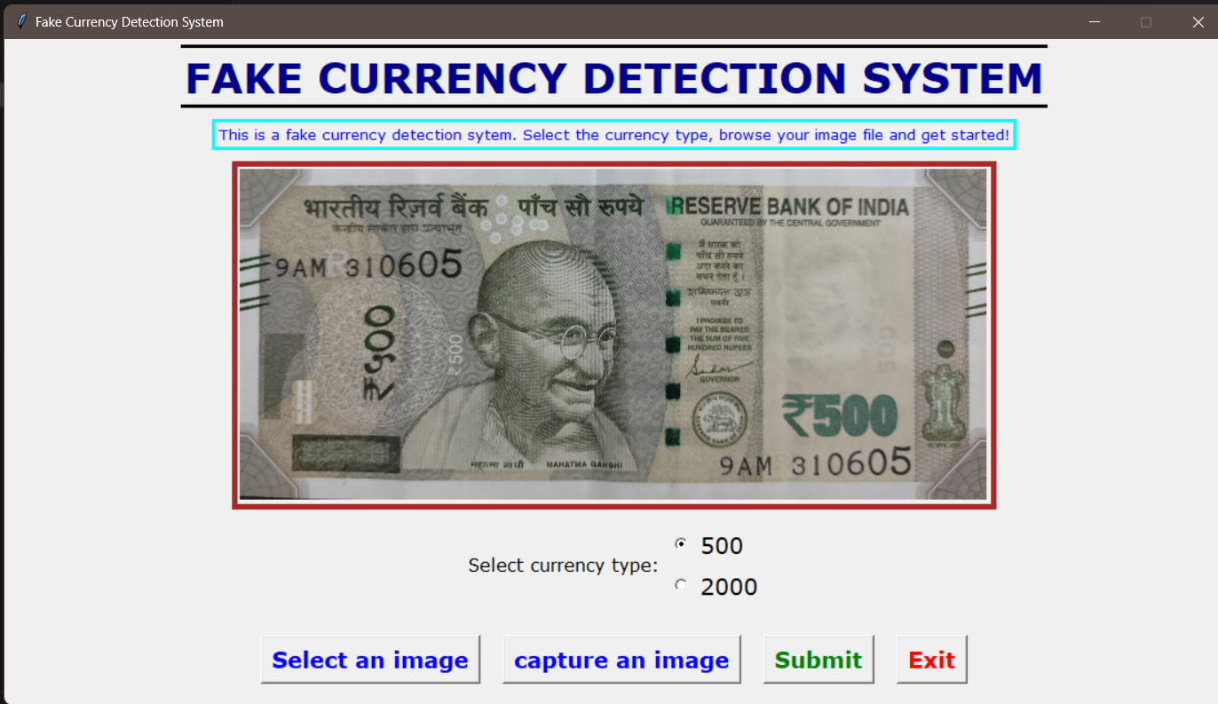
USER INTERFACE

Slide 19
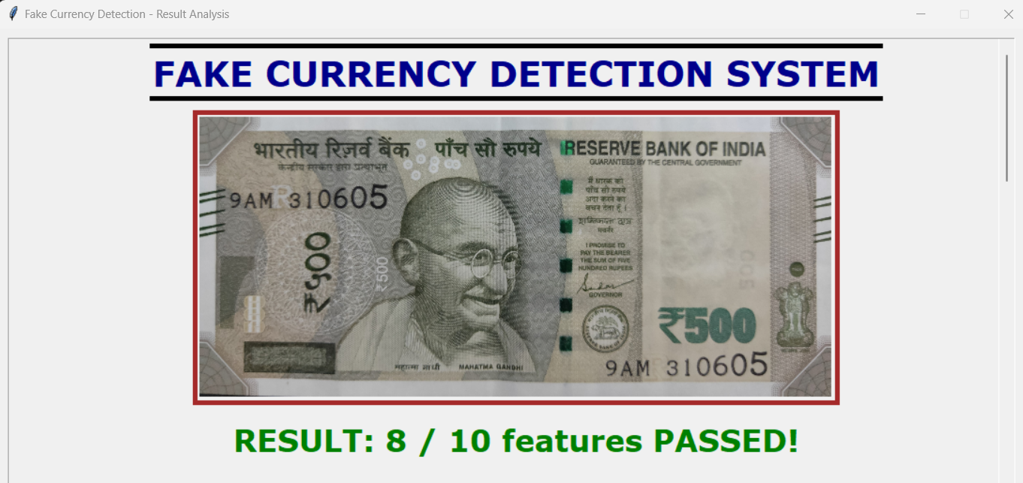
USER INTERFACE

Slide 20
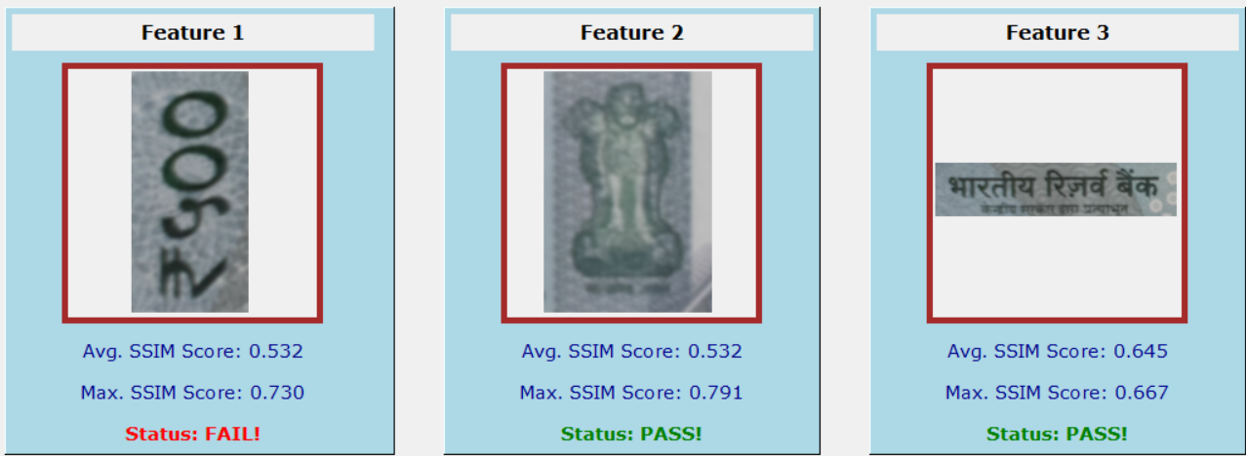
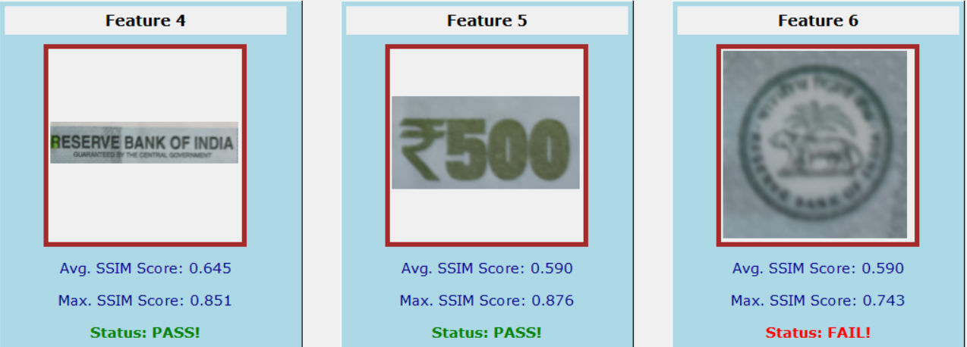
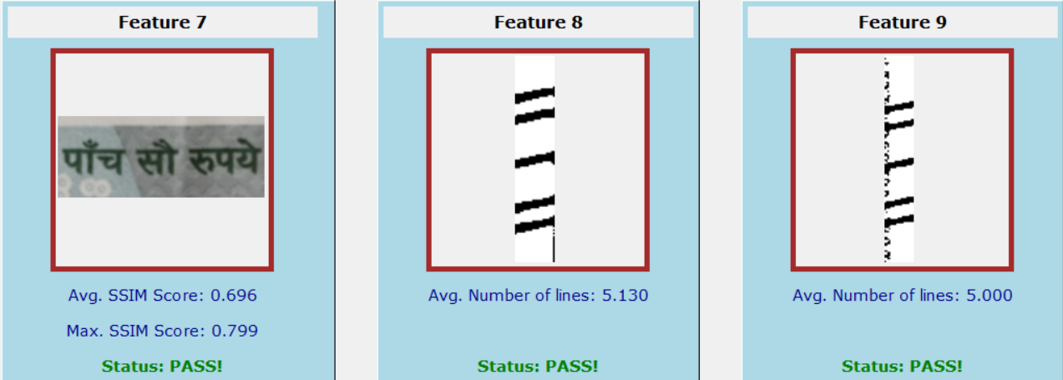
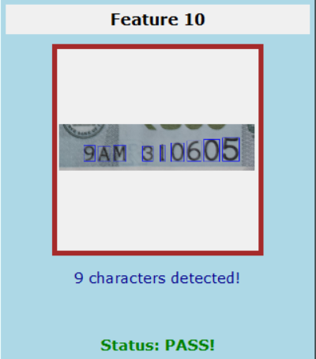
USER INTERFACE

Slide 21
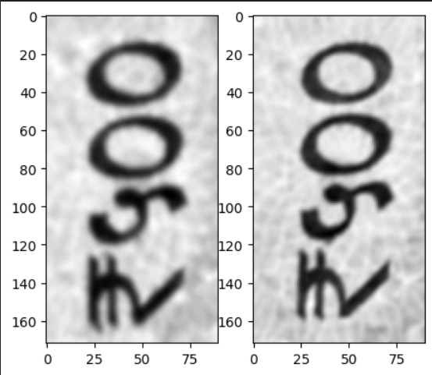
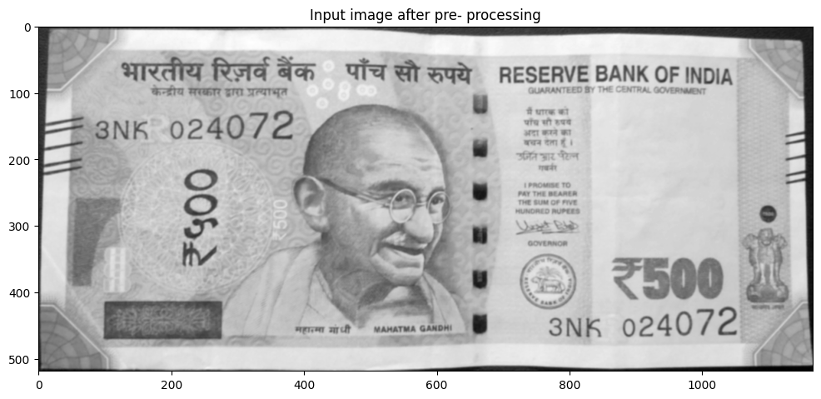

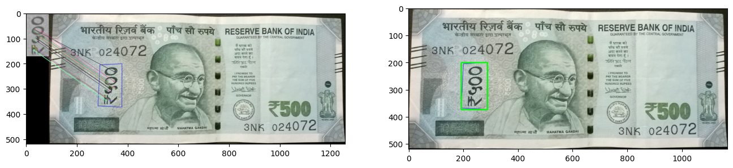
Methodology

Slide 22
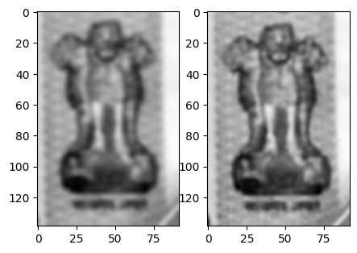
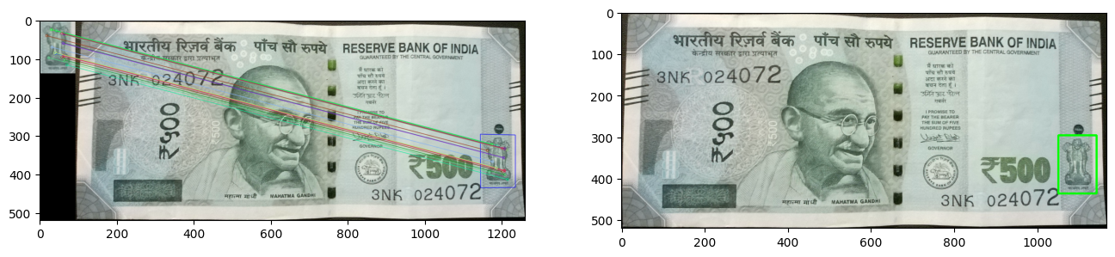
Methodology

Slide 23
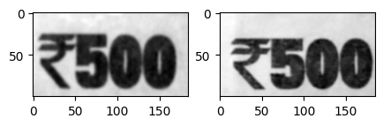
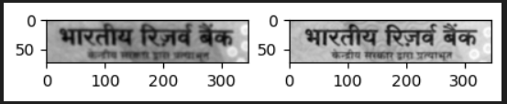
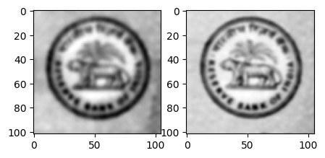
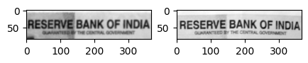
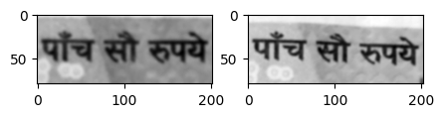
Methodology

Slide 24
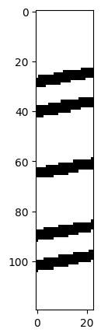
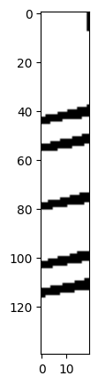
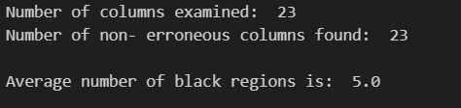
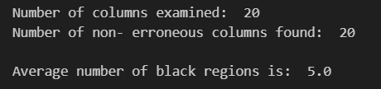
Methodology
ANALYSIS OF FEATURE 8 : LEFT BLEED LINES
ANALYSIS OF FEATURE 9 : RIGHT BLEED LINES

Slide 25
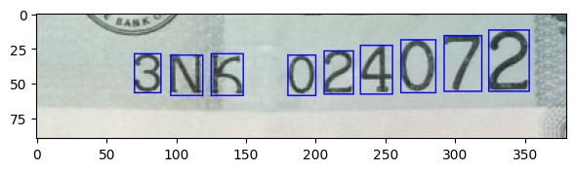
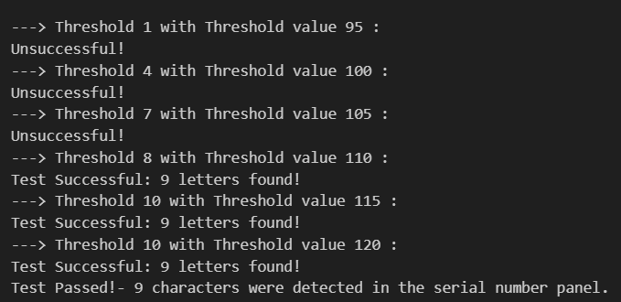
Methodology
ANALYSIS OF FEATURE 10 : NUMBER PANEL

Slide 26
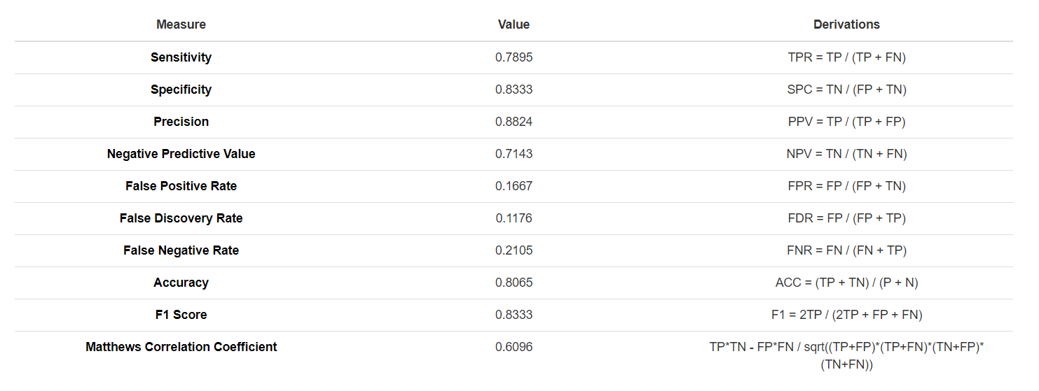
Testing

Slide 27
Challenges Faced
Sophistication of Counterfeits: Counterfeiters use advanced technology to mimic security features, making it crucial for detection systems to evolve continuously.
Variety of Security Features: Currency notes incorporate multiple security features like holograms, watermarks, and microprinting. Detecting these requires complex mechanisms.
False Positives/Negatives: Systems must accurately identify counterfeits without misidentifying genuine currency to maintain trust.
Speed and Efficiency: Detection systems must process large volumes of currency quickly without compromising accuracy

Slide 28
Future Enhancements
Enhanced Image Processing: Developing more advanced image processing techniques that can detect subtle discrepancies in note textures, colors, and security features
International Standards Compliance: Ensuring that the model adheres to international standards for counterfeit detection to facilitate global interoperability.

Slide 29
Conclusion
A model for detecting fake Indian currency notes (500 and 2000 denominations) uses OpenCV and Python3. It analyzes 10 features of the note using 3 algorithms. The input is an image browsed via a Tkinter GUI. The model processes an image in about 5 seconds, achieving 79% accuracy for genuine notes and 83% for counterfeit ones giving the f1 score of 0.8333 .

